Slide 1

PROKARYOTES, VIRUSES, PROTISTANS AND FUNGI
INTRODUCTION TO BIOLOGY (BIO-101)
LECTURE-13

Slide 2

Prokaryotes
Prokaryotes are organisms whose cells lack a nucleus and other membrane-bound organelles.
Prokaryotes are divided into two distinct groups:
  Bacteria
  Archaea
Fossils show that prokaryotes were already here on Earth , 5 billion years ago, and scientists think that prokaryotic ancestors gave rise to all of the life forms present on Earth today.

Slide 3
Prokaryotic Characteristics
  Lack nuclear membrane
  Mitochondria, golgi bodies, chloroplast, and lysosomes are absent
  Genetic material is present on a single chromosome
  The histone proteins, the important constituents of eukaryotic chromosomes, are lacking in them
  Cell wall is made up of carbohydrates and amino acids
  Divide asexually by binary fission. The sexual mode of reproduction involves conjugation.

Slide 4
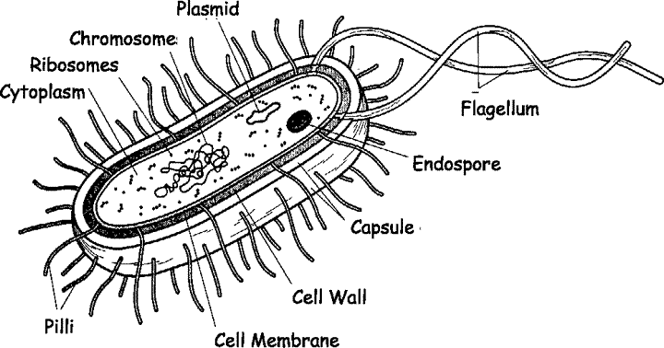
Bacteria
Bacteria are unicellular organisms belonging to the prokaryotic group where the organisms lack a few organelles and a true nucleus.
Figure: Structure of Bacteria

Slide 5
Structure of Bacteria
Name of the organ | Function
Capsule | It helps in attachments as well as it prevent the cell from desiccation and drying.
Flagella | It helps motility of the bacteria
Pili | Hair-like structures that help bacteria attach to surfaces and other bacteria
Cell wall | A rigid wall that gives the cell its structure and protects the plasma membrane
Cell membrane | It is selectively permeable as it allows to pass selective substances such as sugar, amino acids across it.
Cytoplasm | It helps to distribute water, oxygen as other substances throughout the cell
Ribosomes | It helps in protein synthesis
Nucleoid | A mass of genetic material (DNA)
Inclusions | Often reserves of nutrients; additional specialized functions
Plasmid | Extrachromosomal genetic material

Slide 6
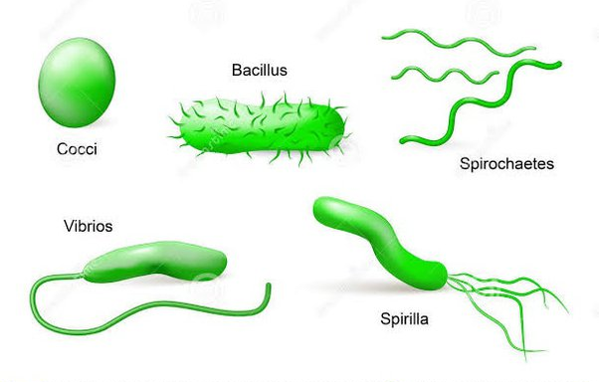
Bacterial Shapes
Bacteria are classified into five groups according to their basic shapes: spherical (cocci), rod (bacilli), spiral (spirilla), comma (vibrios) or corkscrew (spirochaetes).
They can exist as single cell, in pairs, chains or clusters.
coccus
bacillus

Slide 7
Metabolic Diversity
Photoautotrophs are organisms that can make their own energy using light and carbon dioxide via the process of photosynthesis.
Chemotrophs are organisms that obtain energy by the oxidation of electron donors in their environment.
  Chemoautotrophs use inorganic energy sources to synthesize organic compounds from carbon dioxide.
  Chemoheterotrophs are unable to utilize carbon dioxide to form their own organic compounds

Slide 8
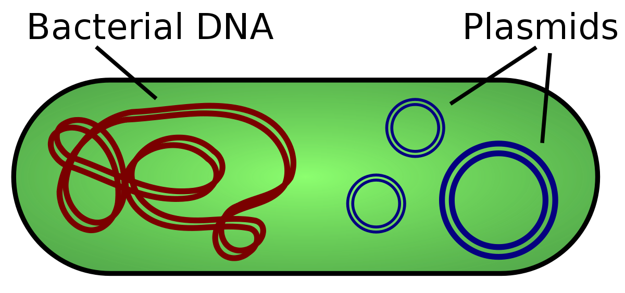
Bacterial Genes
Bacteria have a single chromosome
Many bacteria also have plasmids
A plasmid is a small, circular, double-stranded DNA molecule that is distinct from a cell's chromosomal DNA
  It replicates independently of the chromosomal DNA. It carries additional genes that are usually beneficial to the bacteria.
  Can be passed from one cell to another

Slide 9
Virus
Submicroscopic infectious agent that replicates only inside the living cells of an organism.
The study of viruses are known as virology.
When infected, a host cell is often forced to rapidly produce thousands of copies of the original virus.
Most virus species have virions too small to be seen with an optical microscope and are one-hundredth the size of most bacteria.

Slide 10
Virus
When not inside an infected cell or in the process of infecting a cell, viruses exist in the form of independent particles, or virions, consisting of
the genetic material, i.e., long molecules of DNA or RNA that encode the structure of the proteins by which the virus acts;
a protein coat, the capsid, which surrounds and protects the genetic material; and in some cases
an outside envelope of lipids.
The shapes of these virus particles range from simple helical and icosahedral forms to more complex structures.

Slide 11
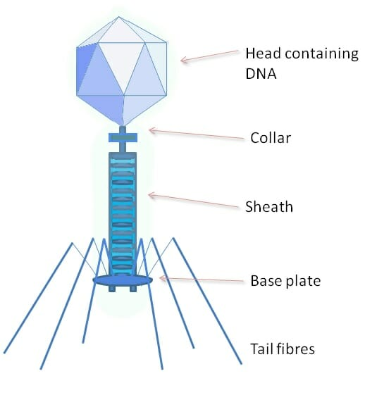
Structure of Virus
Protein coat of a phage is much more complex, and has a variety of specialized parts.
Head portion contains the viral genome.
Collar, sheath, base plate, and tail fibers are part of an intricate system to attach to and inject the genome into a bacterial cell.
Tail fibers grasp the bacterial cell, pulling the base plate up to the cell wall or membrane.
Sheath and collar compress, puncture the cell, and deposit the DNA into the bacterial cell.
Figure: T2 bacteriophage

Slide 12
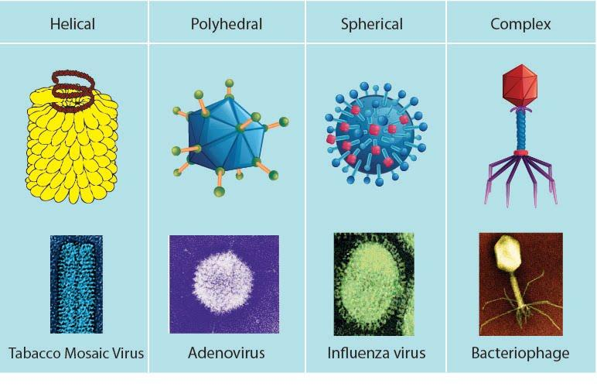
Types of Virus

Slide 13
Protistans Differ From Prokaryotes
A protist is any eukaryotic organism (that is, an organism whose cells contain a cell nucleus) that is not an animal, plant, or fungus.
Examples Amoebas; Diatoms; Plasmodium (which causes malaria); Slime molds

Slide 14

Have a nucleus and organelles
Have proteins associated with DNA
Use microtubules in a cytoskeleton, spindle apparatus, and cilia and flagella
May contain chloroplasts
May divide by mitosis and meiosis

Slide 15

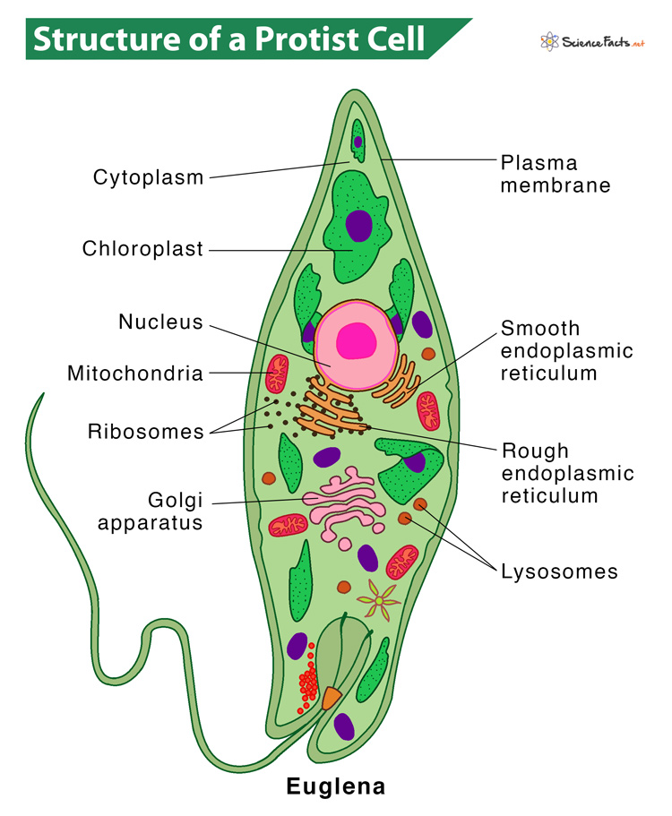

Slide 16
Fungi
A fungus is any member of the group of eukaryotic organisms that includes microorganisms such as yeasts and molds, as well as the more familiar mushrooms.
These organisms are classified under kingdom fungi.

Slide 17
Structure of Fungi
Almost all the fungi have a filamentous structure except the yeast cells
Eukaryotic, non-vascular, non-motile and heterotrophic organisms
Lack chlorophyll and hence cannot perform photosynthesis
They can be either single-celled or multicellular organisms
Fungi consist of long thread-like structures known as hyphae. These hyphae together form a mesh-like structure called mycelium
Cell wall is made up of chitin and polysaccharides
Nucleus is dense, clear, with chromatin threads. The nucleus is surrounded by a nuclear membrane

Slide 18
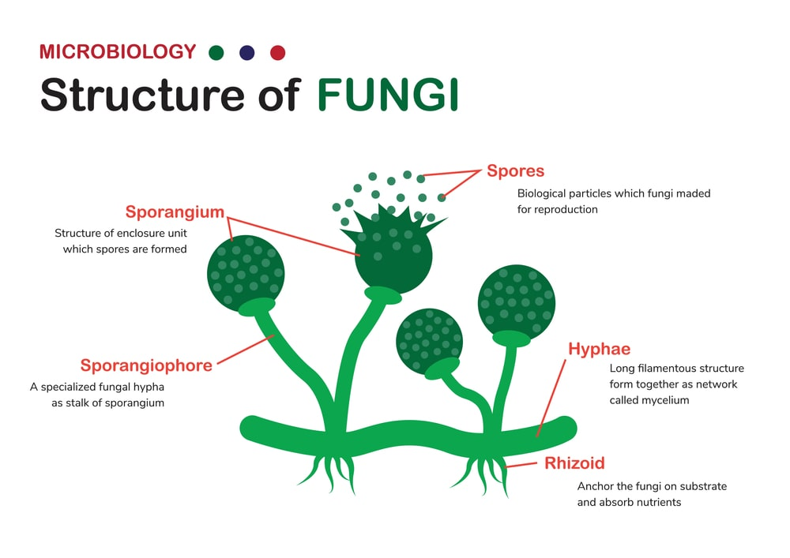
Structure of Fungi

Slide 19
Fungi Are Heterotrophs
Cannot carry out photosynthesis
Must acquire organic molecules from the environment
Most are saprobes
    Get nutrients from nonliving organic matter
Some are parasites
    Extract nutrients from a living host

Slide 20
Various Roles of Fungi
Recycling
Major decomposer of nature, breaks down organic matter which would otherwise not be recycled
Food
The mushrooms species which are cultured are edible and are used as food by humans.
Medicines
Penicillin antibiotic is derived from a common fungus called Penicillium.
Biocontrol Agents
Spores of fungi are used as a spray on crops.
Food spoilage
Can cause major spoilage of stored food.

Slide 21
Fungal Toxins
Chemicals produced by fungi under certain conditions
They are not essential for fungal growth or reproduction, but are toxic to plants, animals or humans.
Fungal toxin contamination in certain agricultural commodities has been a serious concern for animal and human health.
The major toxin-producing fungi are the species of Aspergillus, Penicillium, Fusarium and Alternaria.

Slide 22
Mycotoxin
Mycotoxins are toxic chemical produced by some pathogenic strain of fungi.
Many strains of fungi contaminate the food and produce potent mycotoxin in food.
Disease resulting from ingestion of mycotoxin in food is called mycotoxicosis. e.g. mushroom poisoning.
They are heat stable. So, if mycotoxin is produced in food, it is not damaged easily during normal cooking of food.

Slide 23

Aflatoxin
Patulin
Penicillic acid
Citrinin
Ochratoxin
Sterigmatocystin

Slide 24
THANK YOU

